Slide 1
Chapter 2
The Complexity of Algorithms and the Lower Bounds of Problems
2 -<number>

Slide 2
Measurement of the Goodness of an Algorithm
Time complexity of an algorithm
  worst-case
  average-case
  amortized
2 -<number>
Notes:
Worst-case 最糟情況
Average-case 平均情況
Amortized 平攤情況

Slide 3
Measurement of the Difficulty of a Problem
NP-complete?
2 -<number>

Slide 4
Asymptotic Notations
考
Def: f(n) = O(g(n)) "at most"
∃ c, n₀ ∋ |f(n)| ≤ c|g(n)| ∀ n ≥ n₀
e.g. f(n) = 3n² + 2
g(n) = n²
⇒ n₀=2, c=4
∴ f(n) = O(n²)
e.g. f(n) = n³ + n = O(n³)
e. g. f(n) = 3n² + 2 = O(n³) or O(n¹⁰⁰ )
2 -<number>
Notes:
存在
使得
凡是

Slide 5
考
Def : f(n) = Ω(g(n)) “at least”, “lower bound”
∃ c, and n₀, ∋ |f(n)| ≥ c|g(n)| ∀ n ≥ n₀
e. g. f(n) = 3n² + 2 = Ω(n²) or Ω (n)
Def : f(n) = Θ(g(n))
  ∃ c₁, c₂, and n₀, ∋ c₁|g(n)| ≤ |f(n)| ≤ c₂|g(n)| ∀ n ≥ n₀
e. g. f(n) = 3n² + 2 = Θ (n²)
2 -<number>
Notes:
Def : f(n) = Ω(g(n)) 在問難不難

Slide 6
Problem Size
 | 10 | 10² | 10³ | 10⁴
log₂n | 3.3 | 6.6 | 10 | 13.3
n | 10 | 10² | 10³ | 10⁴
nlog₂n | 0.33x10² | 0.7x10³ | 10⁴ | 1.3x10⁵
n² | 10² | 10⁴ | 10⁶ | 10⁸
2^{n} | 1024 | 1.3x10³⁰ | >10¹⁰⁰ | >10¹⁰⁰
n! | 3x10⁶ | >10¹⁰⁰ | >10¹⁰⁰ | >10¹⁰⁰
Time Complexity Functions
2 -<number>

Slide 7
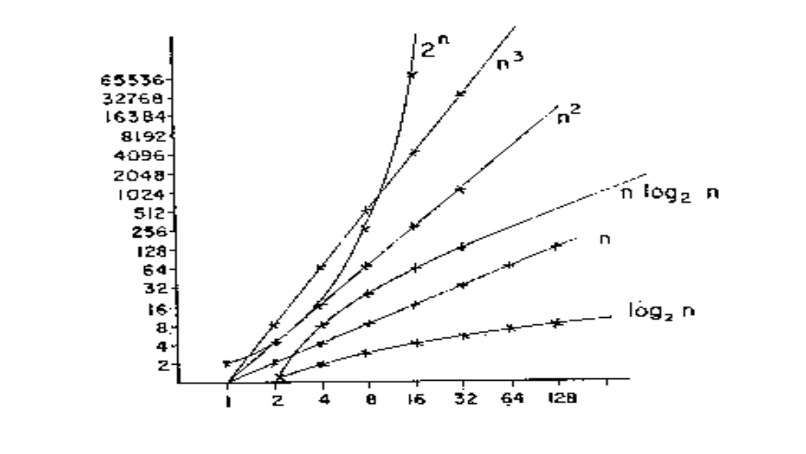
Rate of Growth of Common Computing Time Functions
2 -<number>

Slide 8
Common Computing Time Functions
O(1) < O(log n) < O(n) < O(n log n) < O(n²) < O(n³) < O(2^{n}) < O(n!) < O(n^{n})
2 -<number>

Slide 9
Any algorithm with time-complexity O(p(n)) where p(n) is a polynomial function is a polynomial algorithm. On the other hand, algorithms whose time complexities cannot be bounded by a polynomial function are exponential algorithms.
2 -<number>
Notes:
如果一個演算法的O()是n次方，那他就是多項是時間的演算法，如果是 n!，那就是

Slide 10
Algorithm A: O(n³), algorithm B: O(n).
  Does Algorithm B always run faster than A?
  Not necessarily.
  But, it is true when n is large enough!
2 -<number>

Slide 11
Analysis of Algorithms
Best case
Worst case
Average case
2 -<number>

Slide 12
Straight Insertion Sort
input: 7,5,1,4,3
7,5,1,4,3
5,7,1,4,3
1,5,7,4,3
1,4,5,7,3
1,3,4,5,7
2 -<number>

Slide 13
Algorithm 2.1 Straight Insertion Sort
Input: x₁,x₂,...,x_{n}
Output: The sorted sequence of x₁,x₂,...,x_{n}
For j := 2 to n do
Begin
i := j-1
x := x_{j}
While x<x_{i} and i > 0 do
Begin
x_{i+1} := x_{i}
i := i-1
End
x_{i+1} := x
End
2 -<number>

Slide 14
Inversion Table
(a₁,a₂,...,a_{n}) : a permutation of {1,2,...,n}
(d₁,d₂,...,d_{n}): the inversion table of (a₁,a₂,...a_{n})
d_{j}: the number of elements to the left of j that are greater than j
e.g. permutation (7 5 1 4 3 2 6)
inversion table (2 4 3 2 1 1 0)
e.g. permutation (7 6 5 4 3 2 1)
inversion table (6 5 4 3 2 1 0)
2 -<number>
Notes:
Permutation
Imversion table

Slide 15
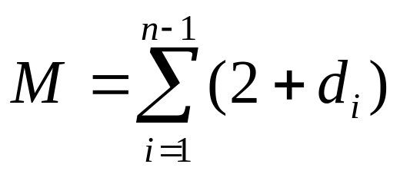
Analysis of # of Movements
M: # of data movements in straight insertion sort
1 5 7 4 3
temporary
e.g. d₃=2
2 -<number>

Slide 16
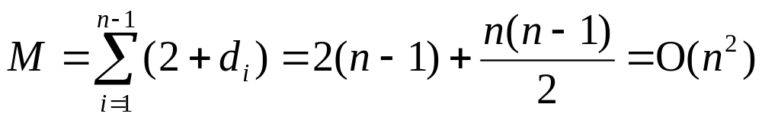
Analysis by Inversion Table
best case: already sorted
d_{i} = 0 for 1 ≤ i ≤ n
⇒M = 2(n − 1) = O(n)
worst case: reversely sorted
d₁ = n − 1
d₂ = n − 2
:
d_{i} = n − i
d_{n} = 0
2 -<number>

Slide 17
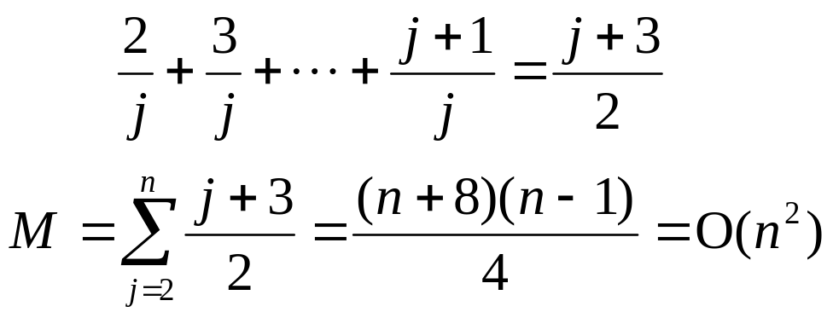
average case:
x_{j} is being inserted into the sorted sequence
x₁ x₂ ... x _{j-1}
The probability that x_{j} is the largest is 1/j.
  In this case, 2 data movements are needed.
The probability that x_{j} is the second largest is 1/j .
  In this case, 3 data movements are needed.
:
# of movements for inserting x_{j}:
2 -<number>

Slide 18
Binary Search
Sorted sequence : (search 9)
1 4 5 7 9 10 12 15
Step 1 ↑
Step 2 ↑
Step 3 ↑
best case: 1 step = O(1)
worst case: (⎣log₂ n⎦+1) steps = O(log n)
average case: O(log n) steps
2 -<number>

Slide 19
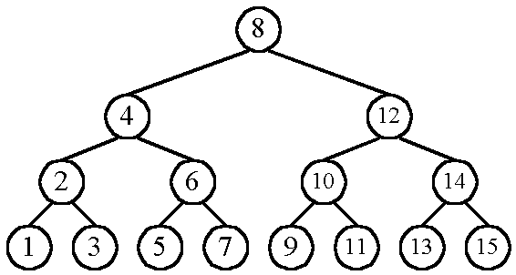
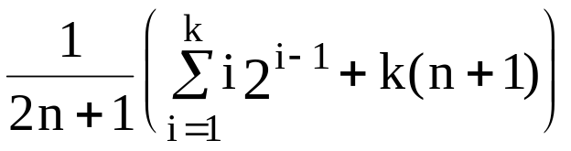
    n cases for successful search
    n+1 cases for unsuccessful search
    Average # of comparisons done in the binary tree:
    A(n) = , where k = ⎣log n⎦+1
有搜尋到
沒搜尋到
2 -<number>

Slide 20
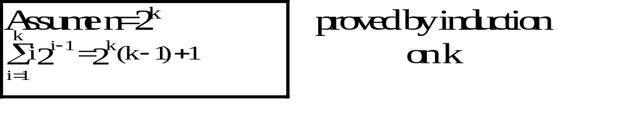
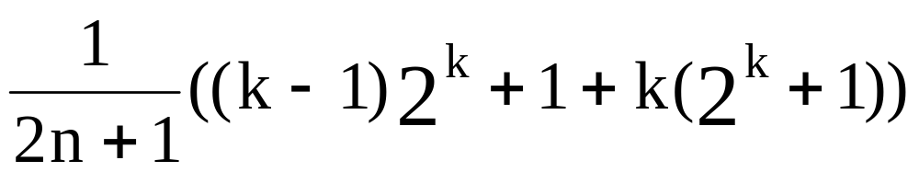
      A(n) =
      ≈ k as n is very large
      = log n
      = O(log n)
2 -<number>

Slide 21
Straight Selection Sort
7 5 1 4 3
1 5 7 4 3
1 3 7 4 5
1 3 4 7 5
1 3 4 5 7
We consider the # of changes of the flag which is used for selecting the smallest number in each iteration.
  best case: O(1)
  worst case: O(n²)
  average case: O(n log n)
2 -<number>
Notes:
swap

Slide 22
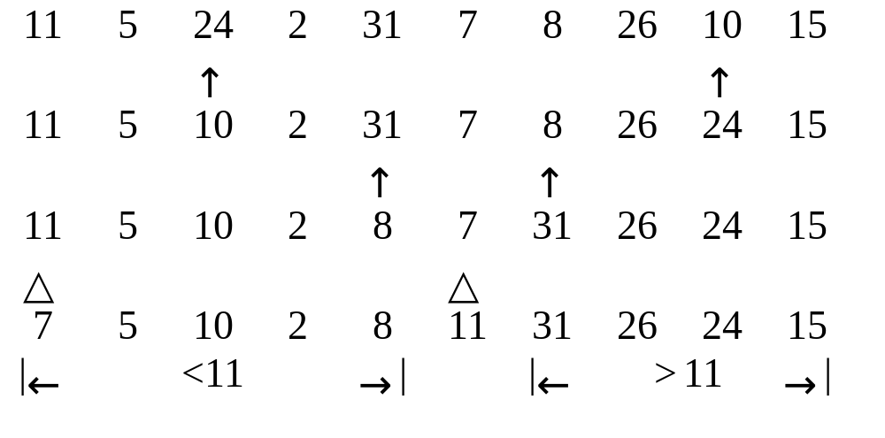
Quick Sort
Recursively apply the same procedure.
2 -<number>

Slide 23
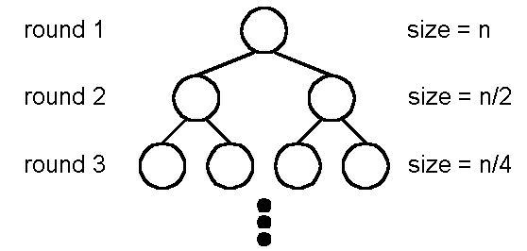
Best Case of Quick Sort
Best case: O(n log n)
A list is split into two sublists with almost equal size.
log n rounds are needed
In each round, n comparisons (ignoring the element used to split) are required.
2 -<number>

Slide 24
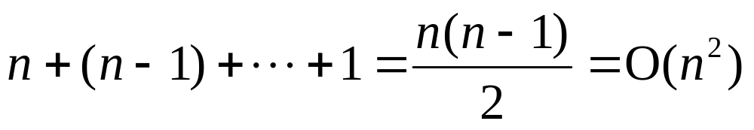
Worst Case of Quick sort
Worst case: O(n²)
In each round, the number used to split is either the smallest or the largest.
2 -<number>

Slide 25
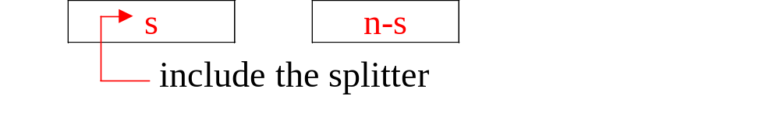
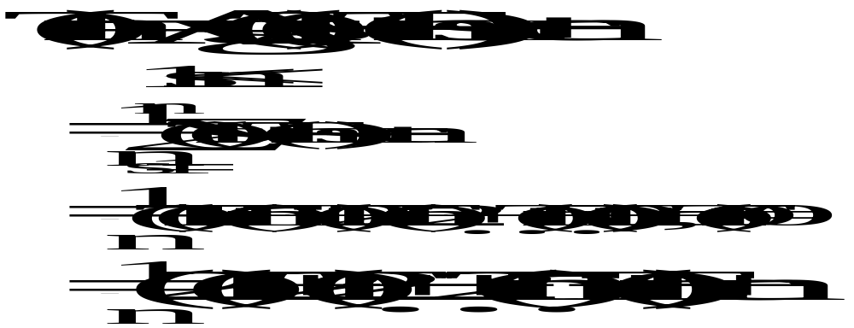
Average Case of Quick Sort
Average case: O(n log n)
2 -<number>

Slide 26
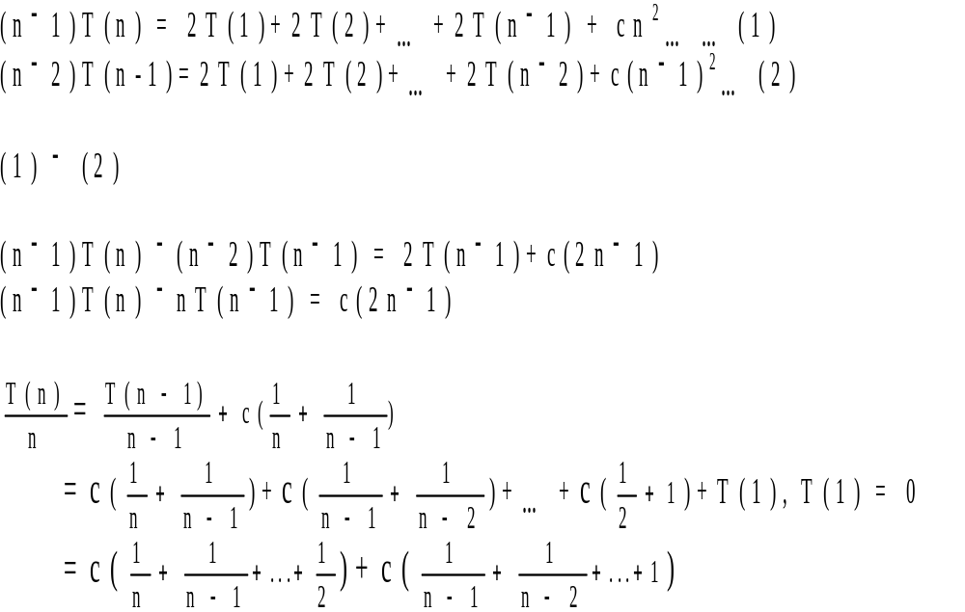
2 -<number>

Slide 27
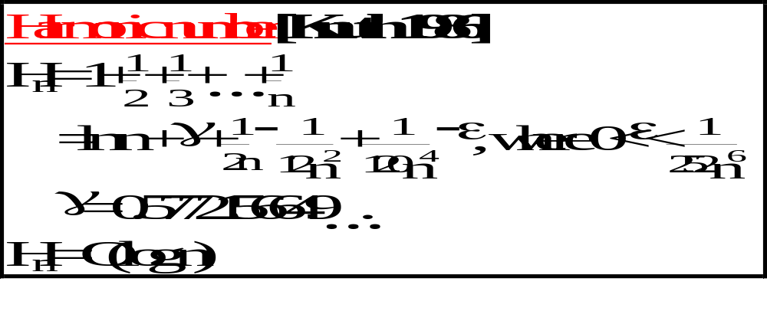
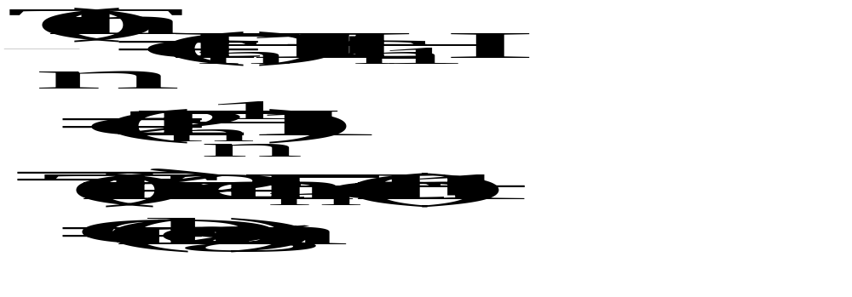
2 -<number>

Slide 28
2-D Ranking Finding
Def: Let A = (a₁,a₂), B = (b₁,b₂). A dominates B iff a₁> b₁ and a₂ > b₂.
Def: Given a set S of n points, the rank of a point x is the number of points dominated by x.
D
B
A
C
E
rank(A)= 0 rank(B) = 1 rank(C) = 1
rank(D) = 3 rank(E) = 0
2 -<number>

Slide 29
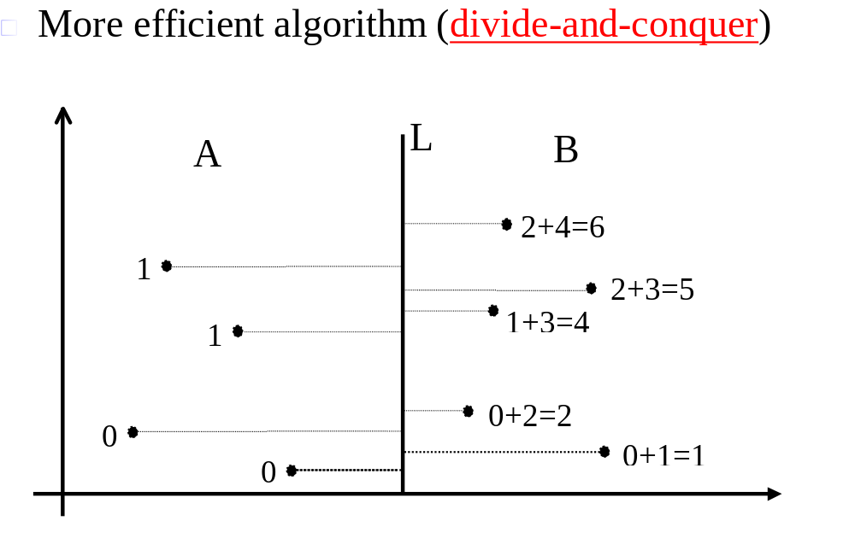
Straightforward algorithm:
Compare all pairs of points: O(n²)
2 -<number>

Slide 30
Divide-and-Conquer 2-D Ranking Finding
Step 1: Split the points along the median line L into A and B.
Step 2: Find ranks of points in A and ranks of points in B, recursively.
Step 3: Sort points in A and B according to their y-values. Update the ranks of points in B.
2 -<number>

Slide 31
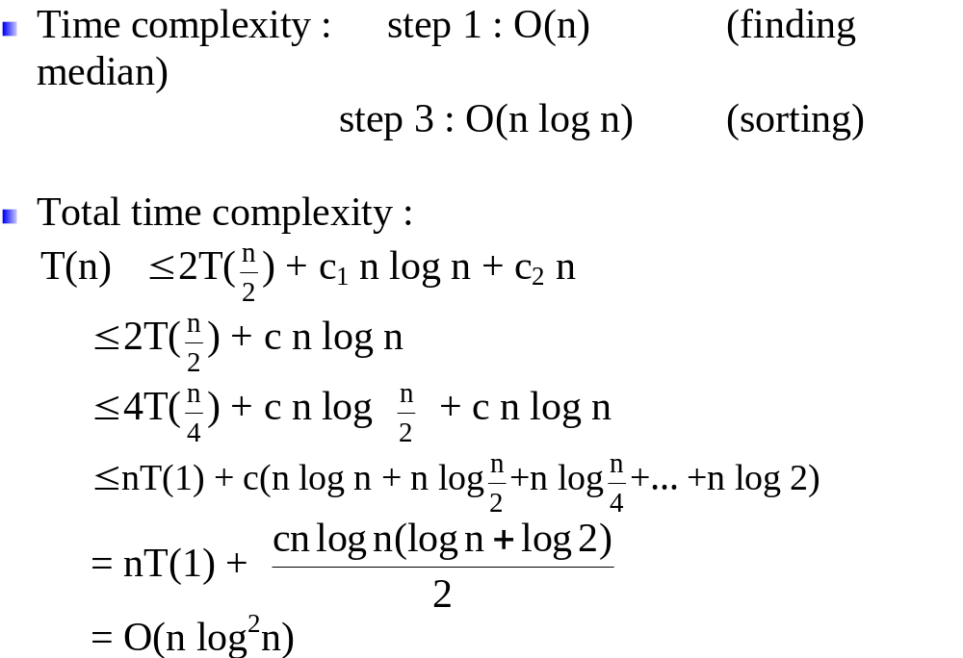
2 -<number>

Slide 32
Lower Bound
Def: A lower bound of a problem is the least time complexity required for any algorithm which can be used to solve this problem.
☆ worst case lower bound
☆ average case lower bound
The lower bound for a problem is not unique.
  e.g. Ω(1), Ω(n), Ω(n log n) are all lower bounds for sorting.
  (Ω(1), Ω(n) are trivial)
2 -<number>

Slide 33
At present, if the highest lower bound of a problem is Ω(n log n) and the time complexity of the best algorithm is O(n²).
  We may try to find a higher lower bound.
  We may try to find a better algorithm.
  Both of the lower bound and the algorithm may be improved.
If the present lower bound is Ω(n log n) and there is an algorithm with time complexity O(n log n), then the algorithm is optimal.
2 -<number>

Slide 34
The Worst Case Lower Bound of Sorting
6 permutations for 3 data elements
a₁ a₂ a₃
1 2 3
1 3 2
2 1 3
2 3 1
3 1 2
3 2 1
2 -<number>

Slide 35
Straight Insertion Sort:
input data: (2, 3, 1)
(1) a₁:a₂
(2) a₂:a₃, a₂↔a₃
(3) a₁:a₂, a₁↔a₂
input data: (2, 1, 3)
(1)a₁:a₂, a₁↔a₂
(2)a₂:a₃
2 -<number>

Slide 36
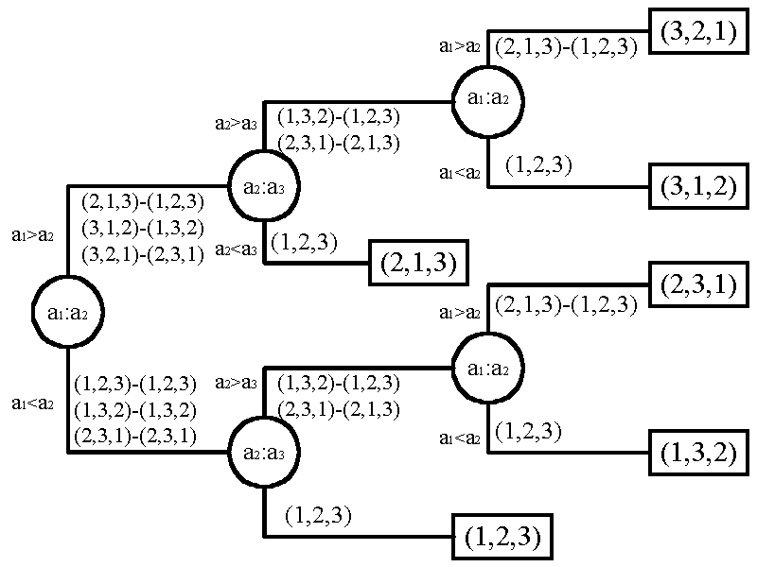
Decision Tree for Straight Insertion Sort
2 -<number>

Slide 37
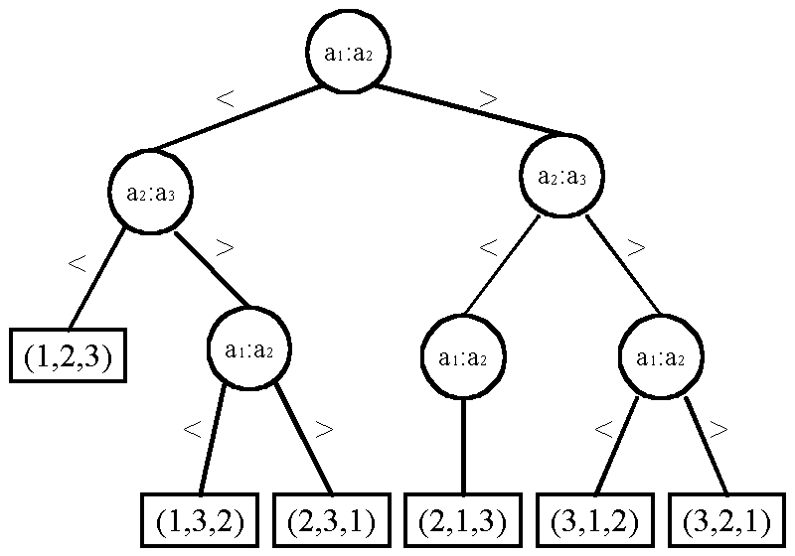
Decision Tree for Bubble Sort
2 -<number>

Slide 38
Lower Bound of Sorting
To find the lower bound, we have to find the smallest depth of a binary tree.
n! distinct permutations
n! leaf nodes in the binary decision tree.
balanced tree has the smallest depth:
⎡log(n!)⎤ = Ω(n log n)
lower bound for sorting: Ω(n log n)
(See next page)
2 -<number>

Slide 39
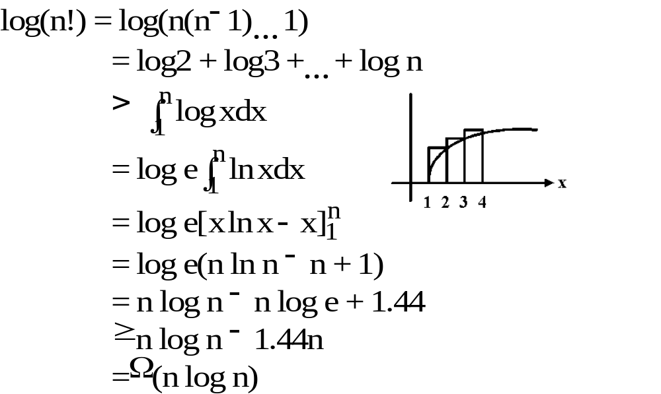
Method 1:
2 -<number>

Slide 40
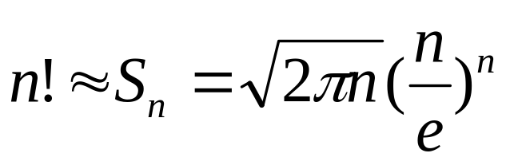
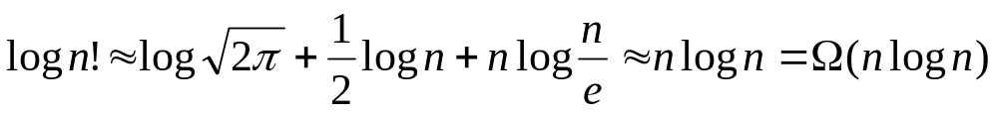
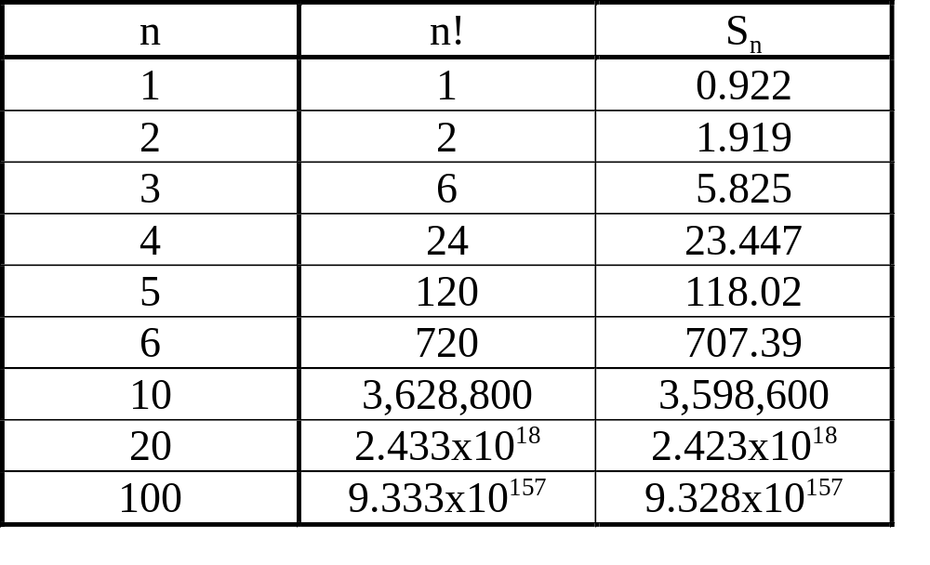
Method 2:
Stirling approximation:
2 -<number>

Slide 41
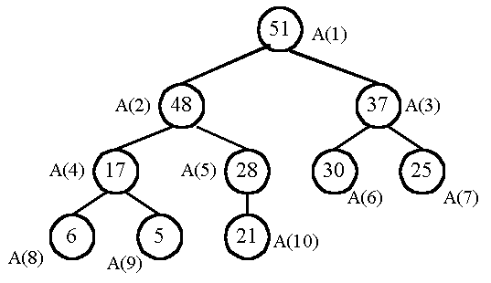
Heap Sort − An optimal sorting algorithm
A heap: parent ≥ son
2 -<number>

Slide 42
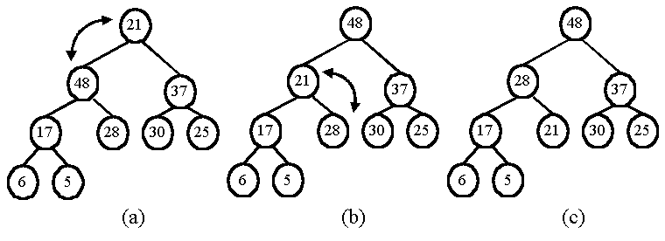
output the maximum and restore:
Heap sort:
  Phase 1: Construction
  Phase 2: Output
2 -<number>

Slide 43
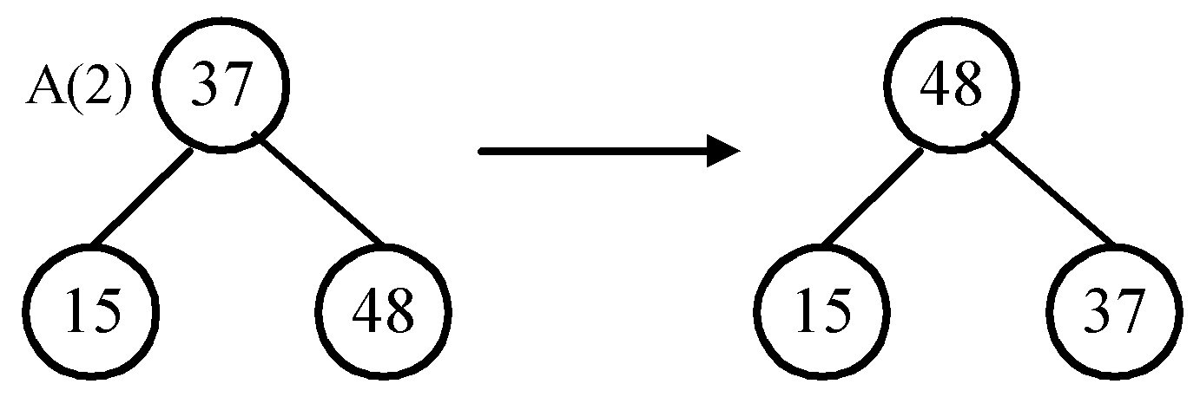
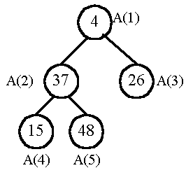
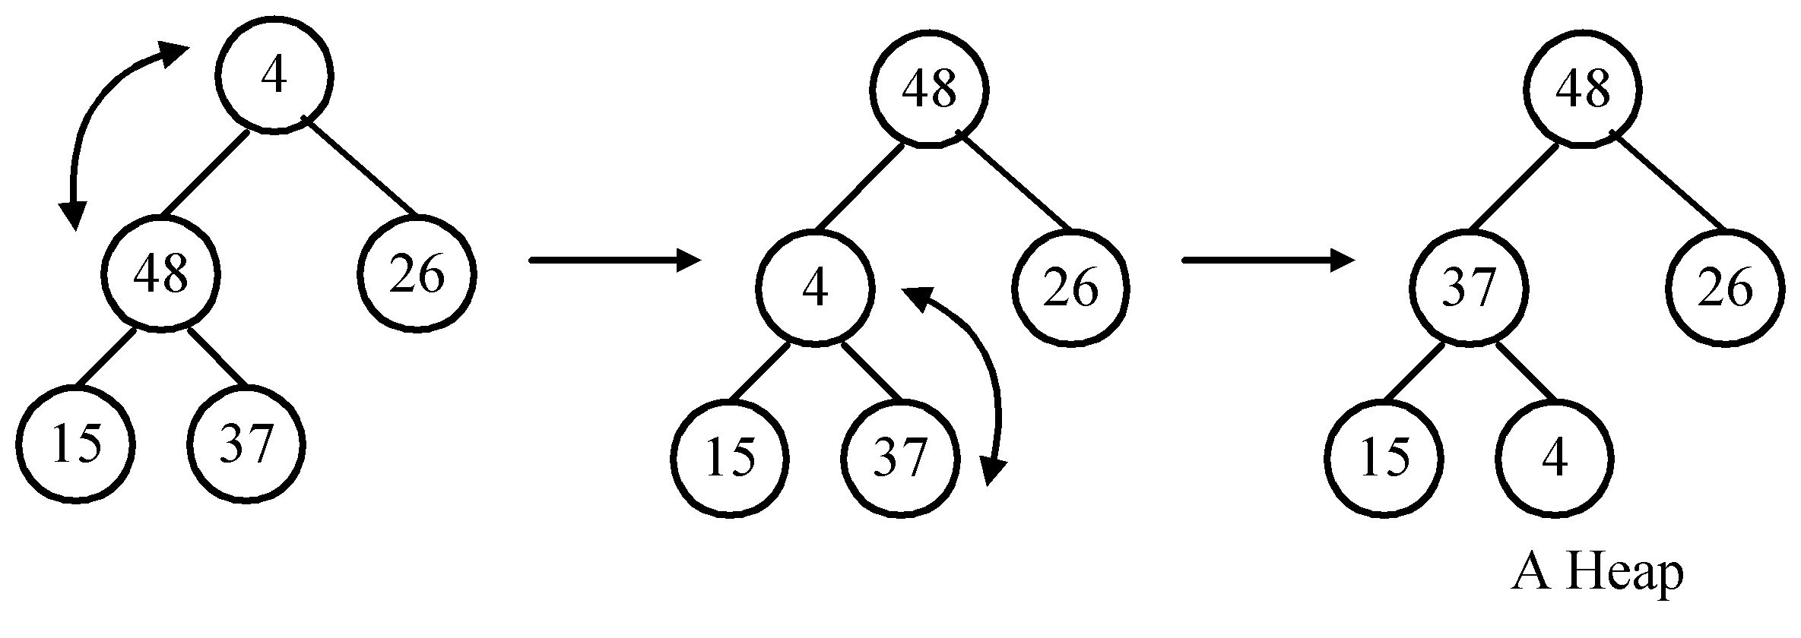
Phase 1: Construction
Input data: 4, 37, 26, 15, 48
Restore the subtree rooted at A(2):
Restore the tree rooted at A(1):
2 -<number>

Slide 44
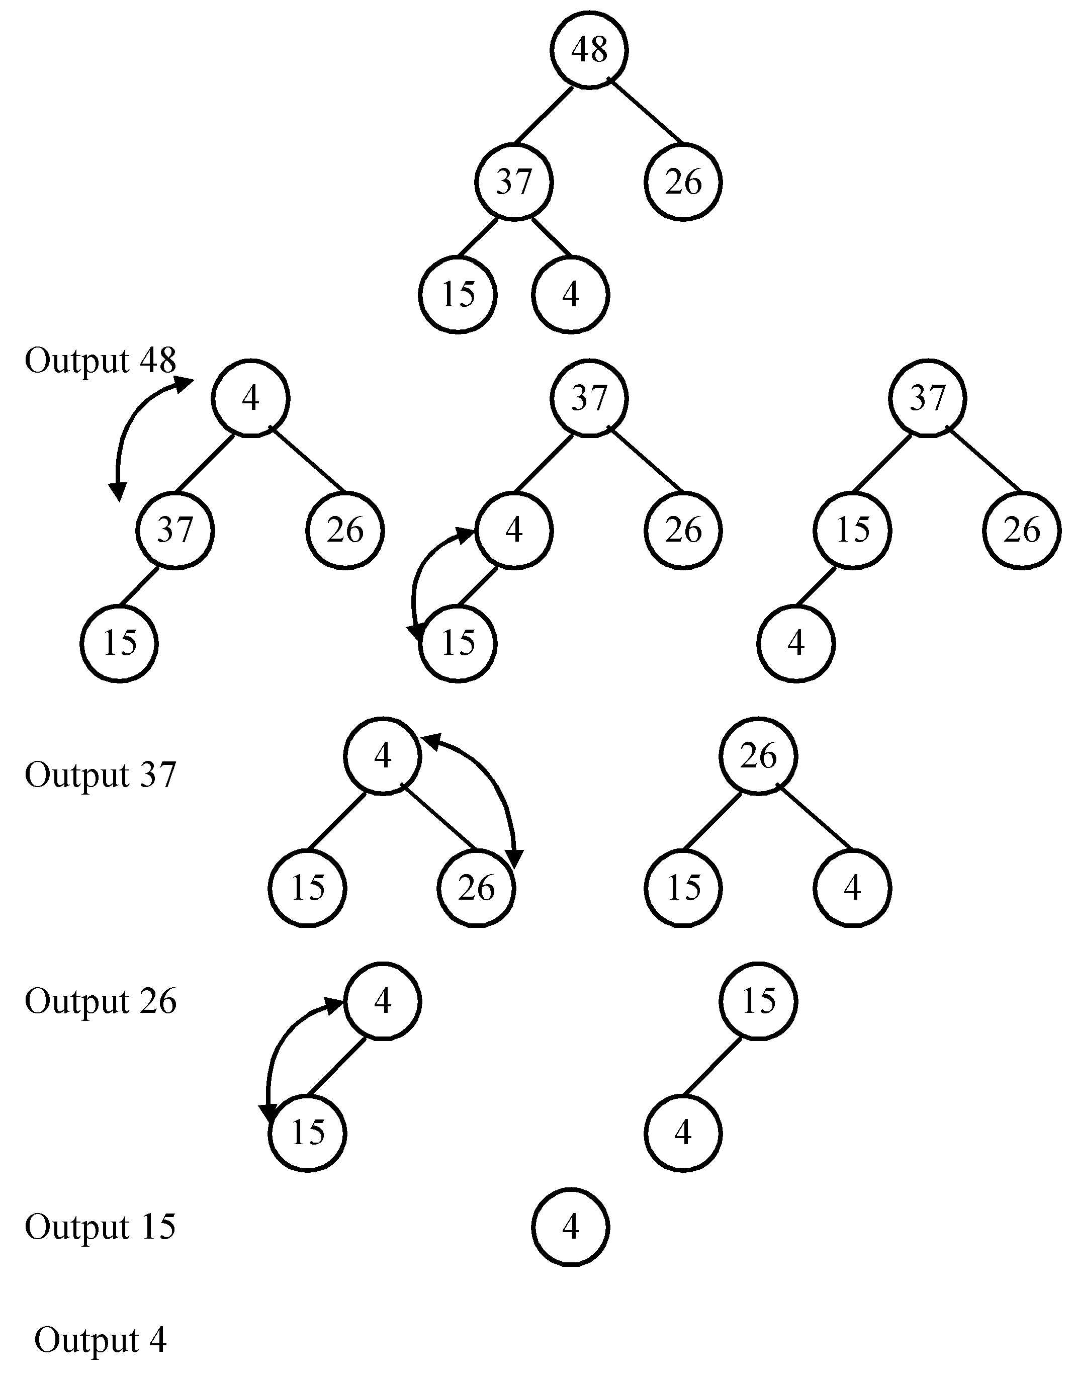
Phase 2: Output
2 -<number>

Slide 45
Implementation
Using a linear array,
not a binary tree.
  The sons of A(h) are A(2h) and A(2h+1).
Time complexity: O(n log n)
2 -<number>

Slide 46
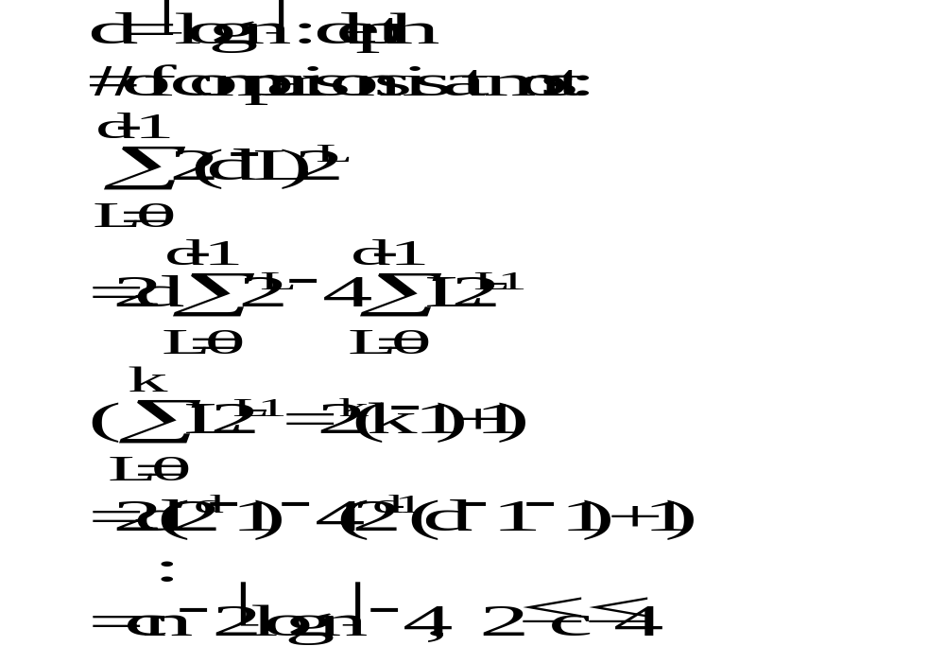
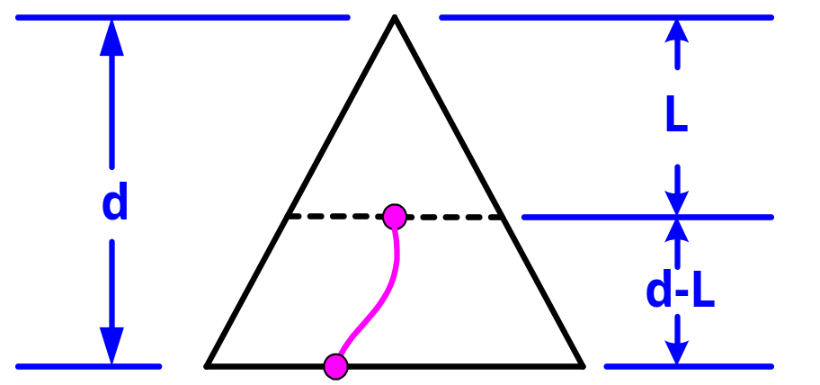
Time Complexity
Phase 1: Construction
2 -<number>

Slide 47
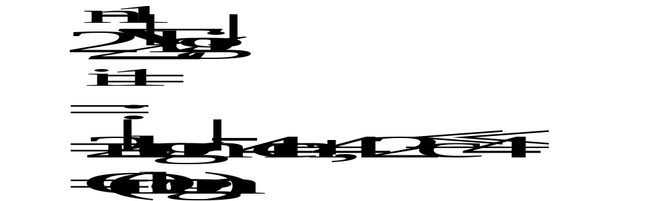
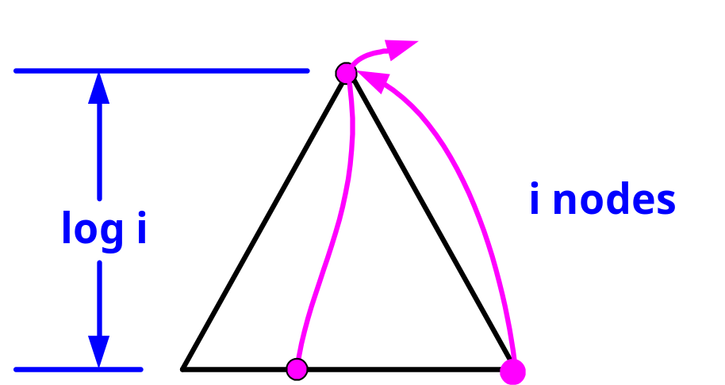
Time Complexity
Phase 2: Output
max
2 -<number>

Slide 48
Average Case Lower Bound of Sorting
By binary decision trees.
The average time complexity of a sorting algorithm:
The external path length of the binary tree
n!
The external path length is minimized if the tree is balanced.
(All leaf nodes on level d or level d−1)
2 -<number>

Slide 49
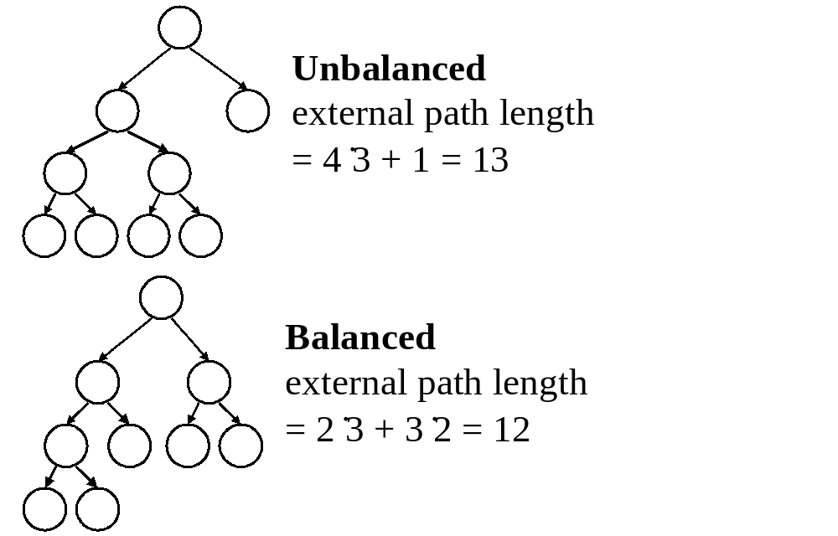
2 -<number>

Slide 50

Compute the Minimum External Path Length
1. Depth of balanced binary tree with c leaf nodes:
d = ⎡log c⎤
Leaf nodes can appear only on level d or d−1.
2. x₁ leaf nodes on level d−1
x₂ leaf nodes on level d
  x₁ + x₂ = c
  x₁ + = 2^{d-1}
⇒ x₁ = 2^{d} −c
x₂ = 2(c − 2^{d-1})
2 -<number>

Slide 51
3. External path length:
M= x₁(d − 1) + x₂d
= (2^{d} − 1)(d − 1) + 2(c − 2^{d-1})d
= c(d − 1) + 2(c − 2^{d-1}), d − 1 = ⎣log c⎦
= c⎣log c⎦ + 2(c − 2^{⎣log c⎦})
4. c = n!
M = n!⎣log n!⎦ + 2(n! − 2^{⎣log n!⎦})
M/n! = ⎣log n!⎦ + 2
= ⎣log n!⎦ + c, 0 ≤ c ≤ 1
= Ω(n log n)
Average case lower bound of sorting: Ω(n log n)
2 -<number>

Slide 52
Quick Sort
Quick sort is optimal in the average case.
(O(n log n) in average)
2 -<number>

Slide 53
Heap Sort
Worst case time complexity of heap sort is O(n log n).
Average case lower bound of sorting: Ω(n log n).
Average case time complexity of heap sort is O(n log n).
Heap sort is optimal in the average case.
2 -<number>

Slide 54
Improving a Lower Bound through Oracles
Problem P: merging two sorted sequences A and B with lengths m and n.
Conventional 2-way merging:
2 3 5 6
1 4 7 8
Complexity: at most m + n − 1 comparisons
2 -<number>

Slide 55
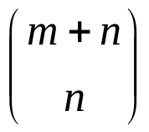
(1) Binary decision tree:
  There are ways !
leaf nodes in the decision tree.
⇒ The lower bound for merging:
⎡log ⎤ ≤ m + n − 1
(conventional merging)
2 -<number>

Slide 56
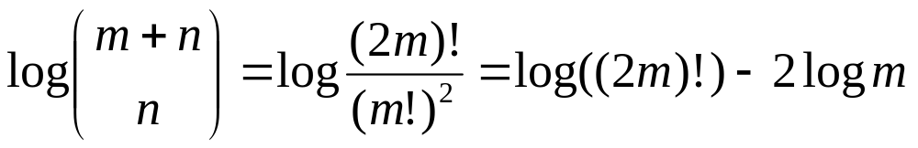
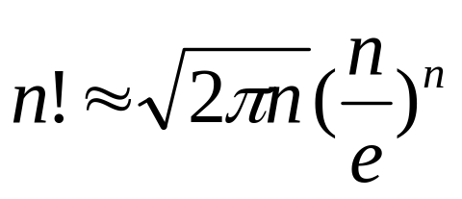
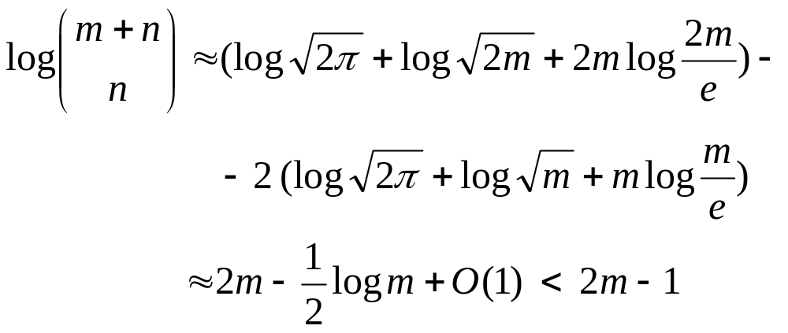
When m = n
Using Stirling approximation
Optimal algorithm: conventional merging needs 2m − 1 comparisons
2 -<number>

Slide 57
(2) Oracle:
The oracle tries its best to cause the algorithm to work as hard as it might (to give a very hard data set).
Two sorted sequences:
  A: a₁ < a₂ < … < a_{m}
  B: b₁ < b₂ < … < b_{m}
The very hard case:
  a₁ < b₁ < a₂ < b₂ < … < a_{m} < b_{m}
2 -<number>

Slide 58
We must compare:
a₁ : b₁
b₁ : a₂
a₂ : b₂
:
b_{m-1} : a_{m-1}
a_{m} : b_{m}
Otherwise, we may get a wrong result for some input data.
e.g. If b₁ and a₂ are not compared, we can not distinguish
a₁ < b₁ < a₂ < b₂ < … < a_{m} < b_{m} and
a₁ < a₂ < b₁ < b₂ < … < a_{m} < b_{m}
Thus, at least 2m−1 comparisons are required.
The conventional merging algorithm is optimal for m = n.
2 -<number>

Slide 59
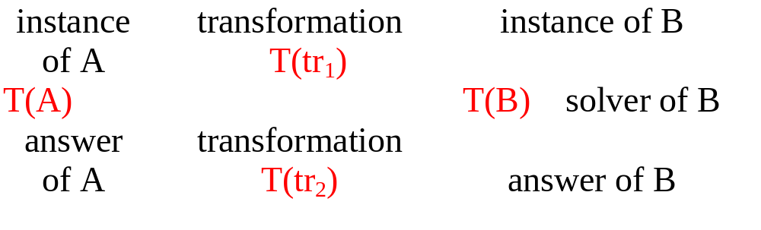
Finding the Lower Bound by Problem Transformation
Problem A reduces to problem B (A∝B)
  iff A can be solved by using any algorithm which solves B.
  If A∝B, B is more difficult.
Note: T(tr₁) + T(tr₂) < T(B)
T(A) ≤ T(tr₁) + T(tr₂) + T(B) ∼ O(T(B))
2 -<number>

Slide 60
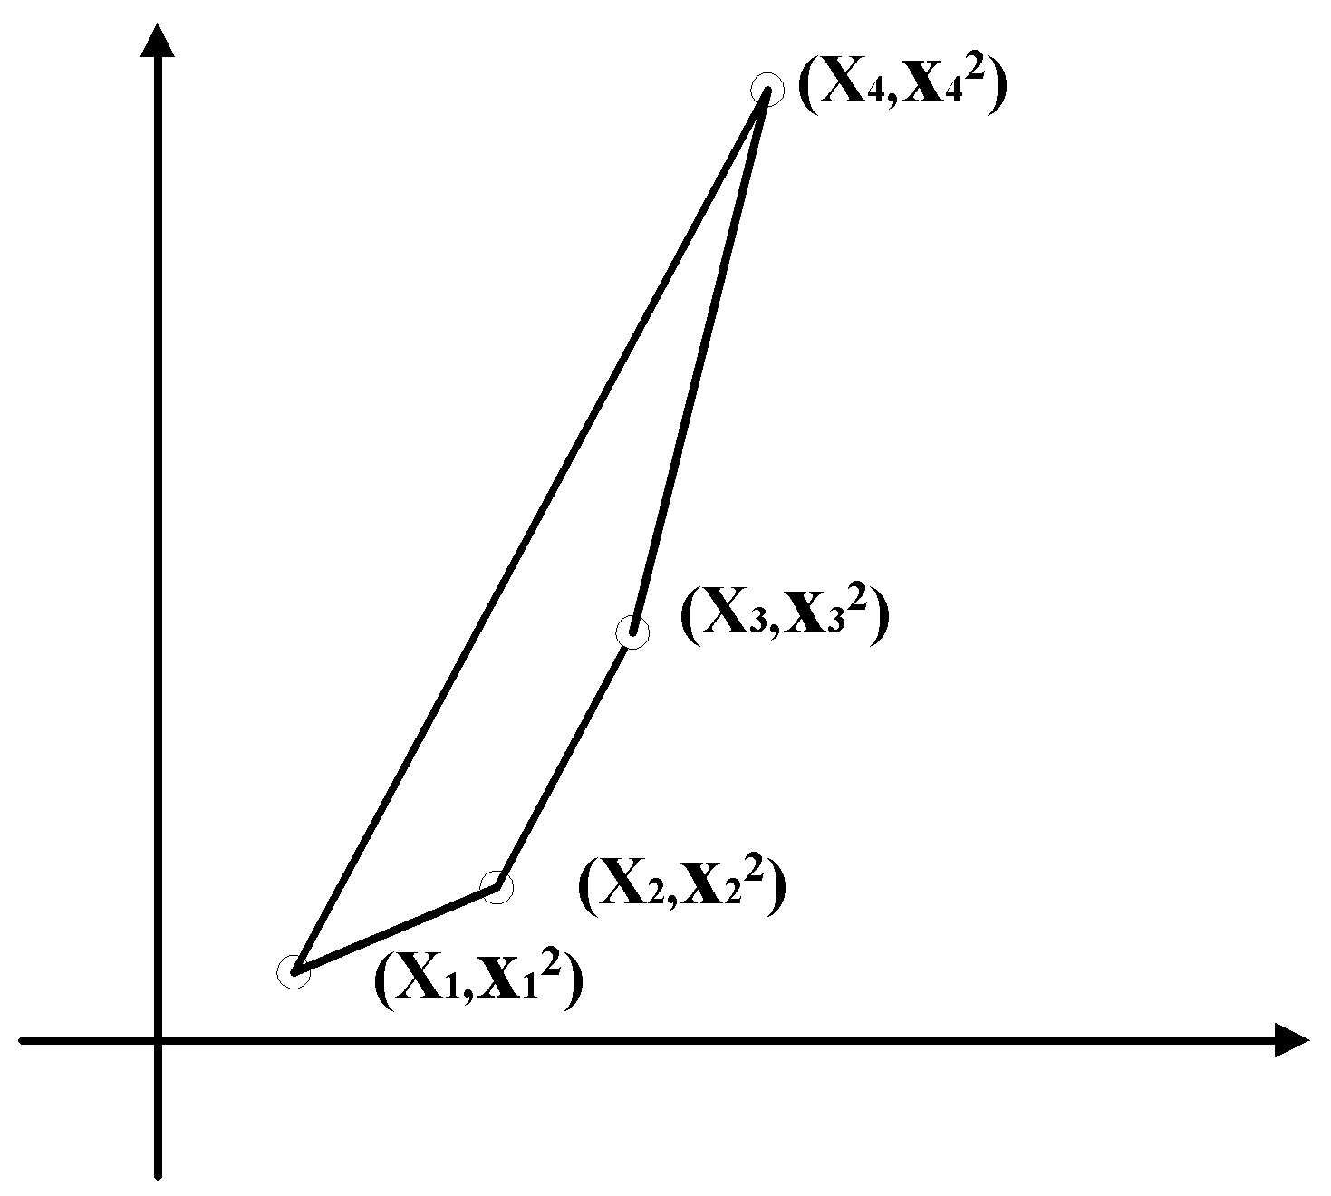
The Lower Bound of the Convex Hull Problem
Sorting ∝ Convex hull
A B
An instance of A: (x₁, x₂,…, x_{n})
↓transformation
An instance of B: {( x₁, x₁²), ( x₂, x₂²),…, ( x_{n}, x_{n}²)}
Assume: x₁ < x₂ < …< x_{n}
2 -<number>

Slide 61
The lower bound of sorting: Ω(n log n)
If the convex hull problem can be solved, we can also solve the sorting problem.
The lower bound of the convex hull problem: Ω(n log n)
2 -<number>

Slide 62
The Lower Bound of the Euclidean Minimal Spanning Tree (MST) Problem
Sorting ∝ Euclidean MST
A B
An instance of A: (x₁, x₂,…, x_{n})
↓transformation
An instance of B: {( x₁, 0), ( x₂, 0),…, ( x_{n}, 0)}
  Assume x₁ < x₂ < x₃ <…< x_{n.}
  ⇔There is an edge between (x_{i}, 0) and (x_{i+1}, 0) in the MST, where 1 ≤ i ≤ n−1.
2 -<number>

Slide 63
The lower bound of sorting: Ω(n log n)
If the Euclidean MST problem can be solved, we can also solve the sorting problem.
The lower bound of the Euclidean MST problem: Ω(n log n)
2 -<number>

